Slide 1
Connectionist Computing
COMP 30230/41390
Gianluca Pollastri
office: CASL, ground floor Science East.
email: gianluca.pollastri@ucd.ie
Connectionist Computing COMP 30230

Slide 2



Credits
Geoffrey Hinton, University of Toronto.
  borrowed some of his slides for “Neural Networks” and “Computation in Neural Networks” courses.
Ronan Reilly, NUI Maynooth.
  slides from his CS4018.
Paolo Frasconi, University of Florence.
  slides from tutorial on Machine Learning for structured domains.
Connectionist Computing COMP 30230

Slide 3
Lecture notes on Moodle
https://csmoodle.ucd.ie/moodle/course/view.php?id=288
Strictly confidential...
Enrolment key: 30230cc
Connectionist Computing COMP 30230

Slide 4
Books
No book covers large fractions of this course.
Parts of chapters 4, 6, (7), 13 of Tom Mitchell’s “Machine Learning”
Parts of chapter V of Mackay’s “Information Theory, Inference, and Learning Algorithms”, available online at:
http://www.inference.phy.cam.ac.uk/mackay/itprnn/book.html
Chapter 20 of Russell and Norvig’s “Artificial Intelligence: A Modern Approach”, also available at:
http://aima.cs.berkeley.edu/newchap20.pdf
More materials later..
Connectionist Computing COMP 30230

Slide 5
Marking
3 landmark papers to read, and submit a 10-line summary on Moodle about: each worth 6.67%
a small connectionist tool to build and play with: 30%
Final exam: 50%
Connectionist Computing COMP 30230

Slide 6
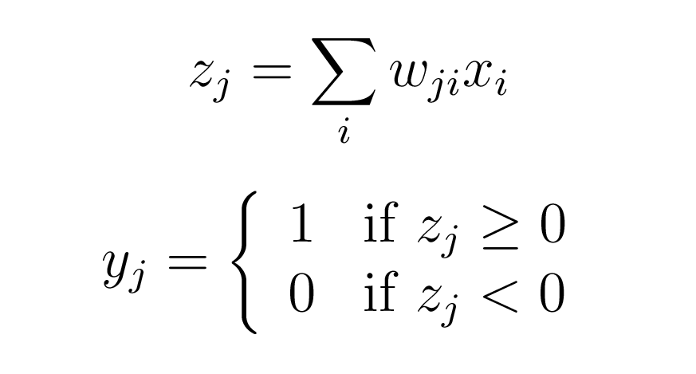
Rosenblatt’s perceptron (’57)
A binary neuron, inputs possibly real-valued:
This is really just a McCulloch-Pitts neuron.. but Rosenblatt actually implemented it on a computer..
Connectionist Computing COMP 30230
Notes:
draw it

Slide 7
Rosenblatt’s contributions
McCulloch-Pitts neuron (’43) and Hebbian learning (’49) implemented in practice.
Computer simulations to study the behaviour of perceptrons
Mathematical analysis of their properties
Rosenblatt was probably the first who talked of “connectionism”.
He studied also perceptrons with multiple layers (see next slide..)
He called “error backpropagation” a procedure to extend the Hebbian idea to multiple layers.
Connectionist Computing COMP 30230

Slide 8
Minsky & Papert: XOR
x₂
x₁ | x₂ | f(x)
0 | 0 | 0
0 | 1 | 1
1 | 0 | 1
1 | 1 | 0
-
+
+
x₂
w₂=?
-
x₁
w₁=?
x₁
No linear separation
surface exists!!
1
w₀= ?
Connectionist Computing COMP 30230

Slide 9
Associators
output
input
A grid is the traditional
way of representing
associators
input
output
Connectionist Computing COMP 30230

Slide 10
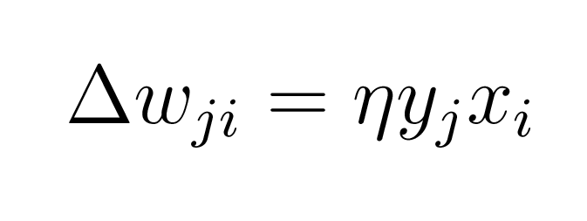
Learning in associators
Learning involves a variation of Hebb’s rule:
yj : j-th output
xi : i-th input
Connectionist Computing COMP 30230

Slide 11
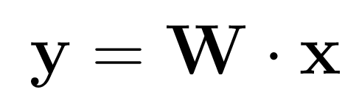
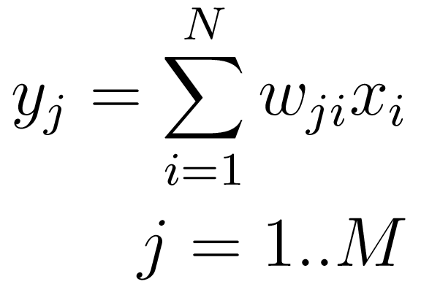
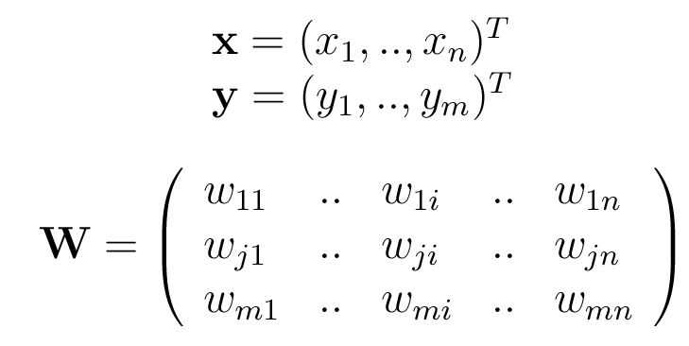
some notation
The network
Can rewrite as:
If we define:
Connectionist Computing COMP 30230

Slide 12
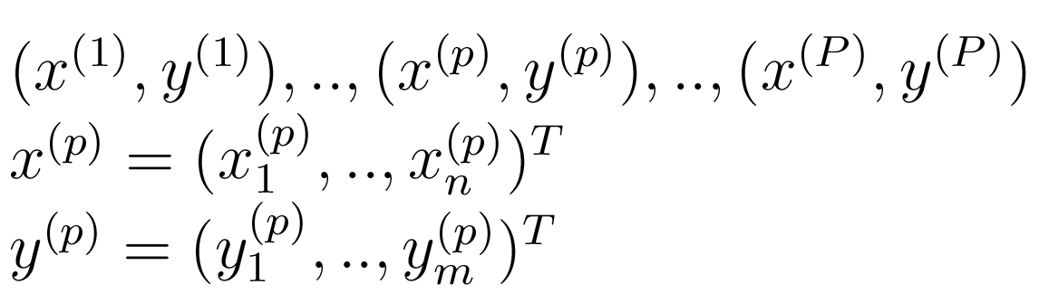
some notation
Set of examples that we want to learn from:
x = inputs, y=outputs
Connectionist Computing COMP 30230

Slide 13
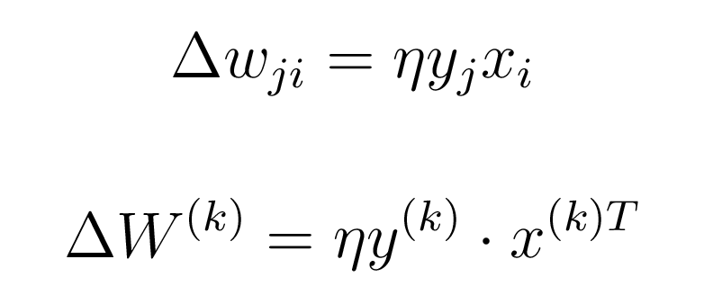
Weight update
Here is the Hebbian learning rule. We can rewrite it for the k-th input-output example using vectors:
Connectionist Computing COMP 30230

Slide 14
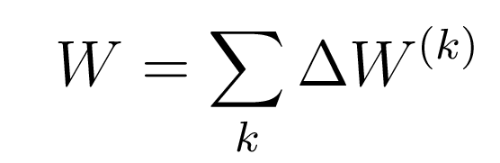
Weight matrix
At the end of a training cycle the overall weight matrix of the associator will be the sum of the updates for each example:
Connectionist Computing COMP 30230

Slide 15
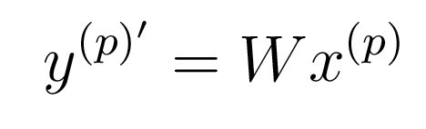
Estimated output
The estimated output for pattern p after a round of weight updates can be written as:
Connectionist Computing COMP 30230

Slide 16
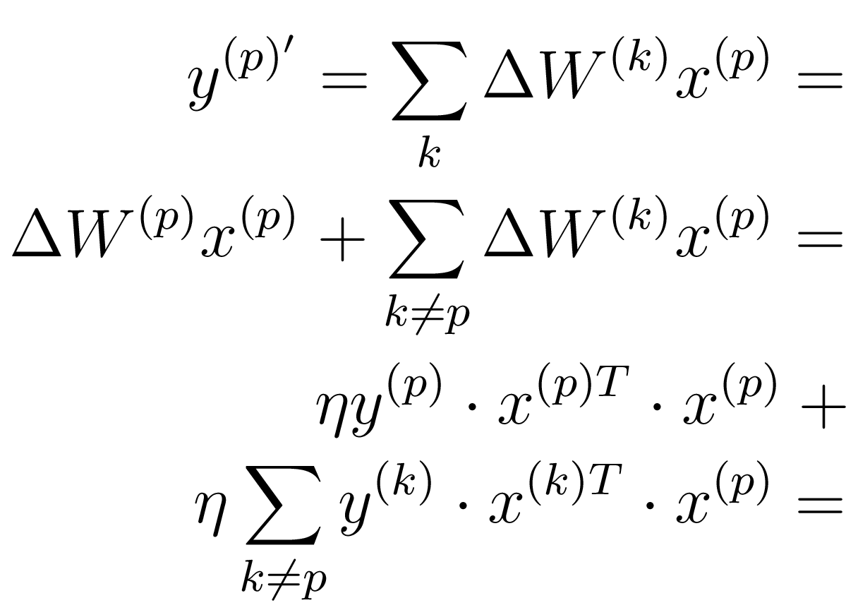
Expanding..
Connectionist Computing COMP 30230

Slide 17
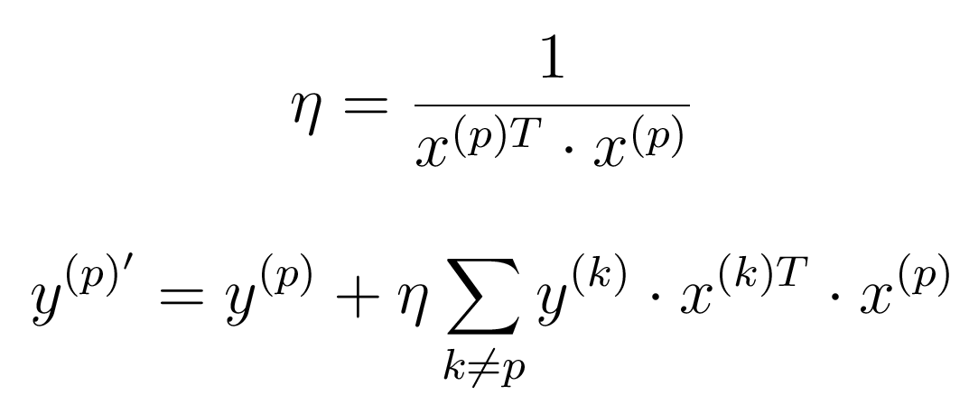
.. expanding ..
By an appropriate selection of η (or if the input vectors are normalised):
Connectionist Computing COMP 30230

Slide 18
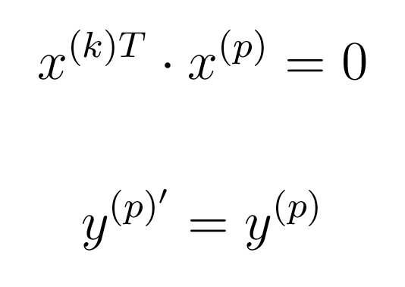
.. finally
If the input patterns are orthogonal the associator shows perfect memory:
If not orthogonal, “crosstalk”
Connectionist Computing COMP 30230

Slide 19
An example
Below is an example of some input-output pattern pairs for a 10x10 associator. The input vectors have been normalised to unit length and are almost orthogonal.
input vectors
required output vectors
i1
.00
-.15
-.29
.88
-.29
-.15
.00
.00
.00
.00
i2
.00
.00
-.06
-.09
-.30
.00
.89
.00
-.30
-.15
i3
-.23
-.23
-.23
.14
.56
.56
.14
-.23
-.23
-.23
o1
1.00
1.00
1.00
1.00
.00
.00
.00
.00
.00
.00
o2
.00
.00
.00
1.00
1.00
1.00
1.00 .00
.00
.00
  .00
o2
.00
.00
.00
.00
.00
.00
1.00 1.00
1.00
1.00 1.00
Connectionist Computing COMP 30230

Slide 20
Resistence to noise
An important property of this simple associative memory is that it is relatively resistent to noise in the input vectors or in the memory matrix itself. If input vectors are auto-associated, the associative memory can be used to reconstruct the input from partial information.
actual output vectors
output vector o3 with corrupt i3
o1
1.00
1.00
1.00
1.03
.03
.03
.00
-.02
-.02
-.02
o2
.03
.03
.03
1.03
1.00
1.00
1.06 .06
.06
.06
o3
-.02
-.02
-.02
.04
.06
.06
1.06
1.00
1.00
1.00
o3 with i3[6]=0
.06
.06
.06
.13
.06
.06
.75
.68
.68
.68
o3 with i3(7-9)=0
-.02
-.02
-.02
-.15
-.13
-.13
.74
.87
.87
.87
crosstalk
effects
Connectionist Computing COMP 30230

Slide 21
Iterative learning procedure
When the number of input patterns increases and the patterns themselves are not orthogonal, the "one-shot" learning approach ceases to be optimal.
An alternative (suggested by Kohonen, 1977) is to repeatedly iterate through a set of patterns, making small weight changes, and attempting to minimise some error measure.
Connectionist Computing COMP 30230

Slide 22
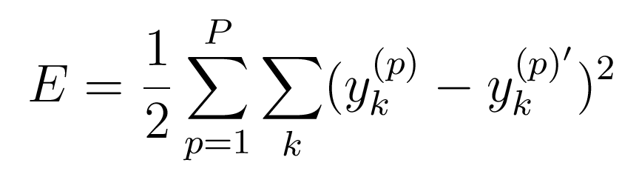
Minimise squared error
A possible error function:
Connectionist Computing COMP 30230

Slide 23
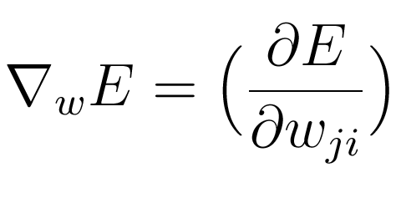
Gradient descent
We can measure the slope of the error function with respect to the parameters, and follow the direction of steepest descent:
Connectionist Computing COMP 30230

Slide 24
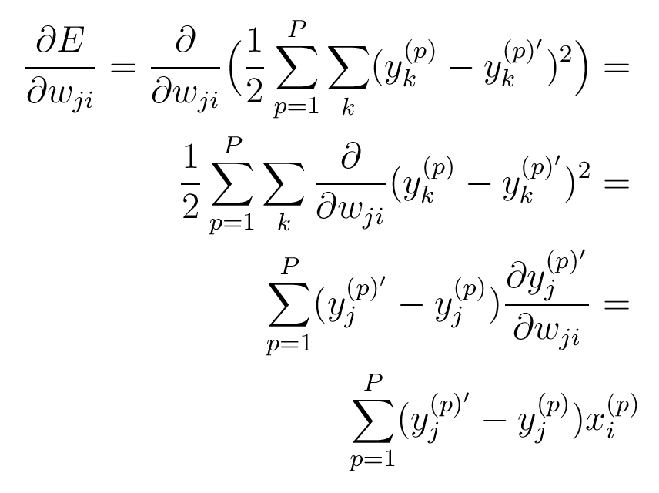
after a minor struggle
Connectionist Computing COMP 30230

Slide 25
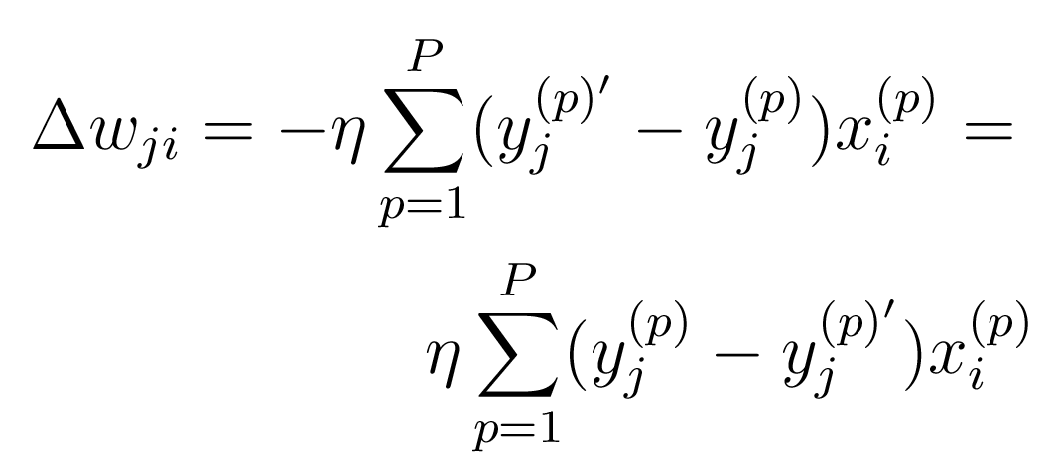
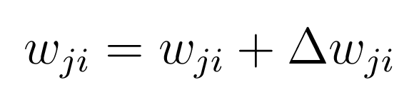
Fairly similar to Hebb’s law
Iterate until satisfied:
Connectionist Computing COMP 30230

Slide 26
Gradient descent and associators
Complexity of gradient computation is minimal: o(nm)
BUT, it is unclear how many steps along the gradient need to be taken…
Much better storage of examples than with one-shot learning, though typically there will be residual error.
Connectionist Computing COMP 30230

